Slide 1



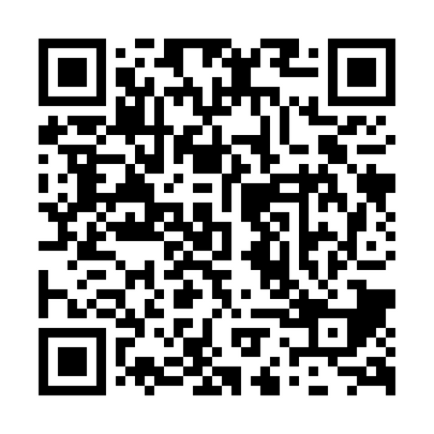
help create tomorrow’s transportation system
Take the SURVEY
Destination2055NC.com
or text “2055ALTS" to 73224

Slide 2

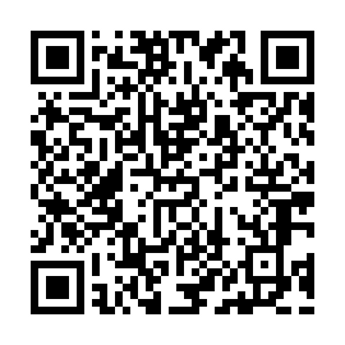
Ayuda a crear el sistema del transporte del mañana
Involúcrate
Destination2055NC.com
or text “2055ALTS" to 73224

